Slide 1

Achievers
BLUE COLLAR CONNECT
Iteration 02
Team Members :
Sneha Reddy Dendi (Team Leader)
Gowtham Reddy Mallu

Slide 2
Table of contents
01
02
03
4
05
6
Business
Wishlist
Identifying Needs
Current business situation and business goals
Desired Goals
Essential Requirements
Requirements
Constraints
Information Techniques
Functional & Non Functional Requirements
Requirement explanation and justification

Slide 3
Table of contents
07
08
09
Q & A
Business Domain Model
Uml Class Diagrams
Domain Information and classification

Slide 4
01 Businesss

Slide 5
Current Business Situation
Our platform links talented individuals from rural areas with city dwellers who require their expertise.
We offer a range of assistance, including resources, mentoring, and job search aid, to rural workers facing challenges with urban migration.
Through our platform, rural workers can access support and job opportunities without having to relocate to cities, thereby strengthening their communities and economies.
Our website uses smart algorithms to help people in cities find the right workers, and helps skilled workers find the right jobs. It's easy for everyone to use and find what they need.

Slide 6

Business Goals
Our platform makes it easy for people in the countryside and cities to share their skills with each other smoothly.
Provide complete support to rural workers that are relocating to cities.
Ensure that users and skilled staff are matched efficiently.
Whether you're offering your skills or looking for assistance, our website really does a great job of ensuring that the right people find each other quickly.

Slide 7
02 Wishlist

Slide 8

Wish List
We're improving how our website looks and works so it's really easy for you to find what you need.
We've set up a system where you can give your opinion on the people who provide services. You can rate them and write reviews to help others.
Integration of a secure payment gateway to ensure smooth transactions.
Services will be expanded to include new categories such as healthcare, education and legal services.

Slide 9
03 Identifying Needs

Slide 10

Identifying Needs
Develop a user-friendly mobile application for easy access and use.
Establishing alliances with NGO organizations to reach and assist more rural workers.
Developing a marketing strategy to increase platform visibility and attract new users.
Enhancing data security procedures to protect user data and respect privacy.

Slide 11
04
Requirements

Slide 12
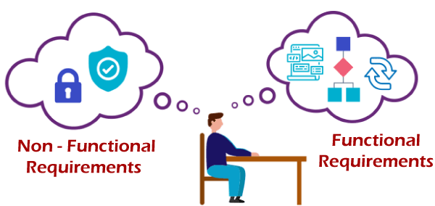
Functional Requirements
User registration and profile creation
People can search and use filters to find the right workers.
Booking and scheduling system for service requests
Users can rate and give feedback on service providers.
Secure payment gateway integration for transactions
Users get notifications for booking confirmations, updates, and reminders.

Slide 13
Functional Requirements
People can sign up on the website using their email or social media accounts.
They can make a profile where they share their personal info, skills, and work history.
Users can search for skilled professionals by location, availability, and skills.
They can hire skilled workers through the website.
There should be a scheduling system that allows users to book appointments with service providers.

Slide 14
Functional Requirements
Users can share their experiences and rate service providers.
The platform displays the average rating of each service provider to help users decide.
It has a safe payment system for transactions between users and service providers.
Users get alerts for booking confirmations, updates, and appointment reminders.
Service providers are notified about new booking requests and schedule changes.

Slide 15
Non-Functional Requirements
Performance: Ensuring the platform can handle many users without issues.
Security: Protecting user data with encryption and secure authentication.
Usability: Making the platform easy to use and understand for all users.

Slide 16
Non-Functional Requirements
The platform should be able to handle a large number of concurrent users without experiencing slowdowns or crashes.
Response times for user actions searching, booking and loading profiles should be fast.
User data should be encrypted both in transit and at rest to protect it from unauthorized access.
The platform should implement secure authentication mechanisms to ensure that only authorized users can access their accounts.
The platform should have a user-friendly interface that is easy to navigate and understand.
Clear and simple instructions should be provided to users on how to use the platform and its features.

Slide 17
Non-Functional Requirements
The platform can accommodate growth in user base.
Frequent backups prevent data loss.
Regular updates and checks ensure smooth operation.
Tracking user behavior and platform performance for improvement.
Providing users with easy access to help and troubleshooting resources.

Slide 18
05 Constraints

Slide 19

Constraints
Limited Budget for Development and Maintenance: Completing the project within a tight budget may restrict the extent of development and the inclusion of certain features.
Limited Development Team: A smaller team size could impact the development speed and the number of features implemented within the timeframe.
Time Constraints for Project Completion: There is a deadline for completing the project, which may limit the amount of time available for development, testing and refinement.

Slide 20
Constraints
Limited Access to Skilled Workers in Rural Areas: The platform's success is dependent on the availability of skilled workers, which can be limited in rural areas. It impacts the scope and caliber of services provided.
Technology Constraints such as Internet Connectivity in Rural Areas: Poor internet connectivity in rural areas reduces platform accessibility for users and service providers. Infrastructure investment, partnerships with local ISPs, and offline functionality options are all potential solutions.

Slide 21
Budget & Time Constraint
The financial limitation is considered a constraint since it reduces the resources available for development and maintenance potentially affecting the platform's scope and quality.
The time constraint is a limitation because it sets a deadline for project completion, which may necessitate prioritizing certain tasks and features above others in order to meet the deadline.

Slide 22
Budget & Time Constraint
The budget limitation influences decisions about which features to prioritize based on cost-effectiveness and user value. It also influence the choice of technology and development approach.
The time constraints has an impact on non-functional needs since it reduces the amount of time available to optimize performance, security and usability. Prioritizing these components required in order to fulfill project deadlines.

Slide 23
Workers & Time Constraint
Limited availability to competent workers in rural areas is a barrier since it makes it difficult to develop a broad and complete pool of service providers on the platform limiting the platform's capacity to meet user needs.
Technology restrictions limited access to the internet in rural areas are considered constraints because they might have an impact on the platform's usability and accessibility.

Slide 24
06 Techniques

Slide 25

Information Techniques
Stakeholder Interviews
Surveys
User Observation
Document Analysis
Brainstorming Sessions

Slide 26
Stakeholder Interviews & Surveys
Individual interviews were conducted with stakeholders rural workers, urban residents and platform administrators.
Identified their platform needs, expectations and problem areas.
Interview results were used to define important requirements and prioritize features based on stakeholder feedback.
Designed and distributed surveys to a sample of users to collect quantitative data.
Analyzed survey responses to identify trends and patterns that influenced the development of requirements.

Slide 27
User Observation & Document Analysis
Users were observed interacting with existing platforms and services in order to better understand their behavior and issues.
Users' problems and areas of difficulty or discontent were noted.
Market research reports, industry studies and competition analysis materials were thoroughly reviewed.
Extracted market trends, user expectations and industry best practices.
The findings served to ensure that platform requirements aligned with industry standards and met user expectations.

Slide 28
Brainstorming Sessions
Conducted brainstorming sessions with the development team to generate ideas for features and functions.
Encouraged team members to think creatively and develop novel methods to fulfill customer requirements.
Used ideas from brainstorming sessions to create a comprehensive list of requirements that aligned with the platform's objectives.

Slide 29
07 Q & A

Slide 30
What is the business, the current business situation, and how does it operate?
The business aims to bridge the gap between skilled workers from rural areas and urban residents seeking their services.
It operates as a centralized platform where users can find and book services from skilled workers.
The platform also provides support and resources for rural workers transitioning to urban areas.

Slide 31

2. What is the system’s environment or context?
The system operates in the context of India's vast population, with significant migration of skilled workers from rural to urban areas.
It addresses the challenges faced by both rural workers and urban residents in finding and providing services.

Slide 32
3. What are existing business processes, their input and output, and how do they relate to each other?
Existing business processes include user registration, service search and booking, payment processing, and feedback collection.
Input includes user information, service requests, and payment details while output includes service bookings, payments, and user feedback.
These processes are interconnected, with user actions triggering various system functions to facilitate service provision.

Slide 33
4. What are the problems with the current system?
Limited access to skilled workers in rural areas.
Challenges in connecting urban residents with skilled workers.
Lack of a centralized platform for efficient service matchmaking.

Slide 34
5. What are the business or product goals?
Facilitate a seamless exchange of skills between rural workers and urban residents.
Provide comprehensive support for rural workers transitioning to urban areas.
Ensure efficient matchmaking between users and skilled workers.

Slide 35
6. Who are the users of the current and future systems, respectively?
Current users include rural workers seeking job opportunities and urban residents looking for services.
Future users include a broader range of users as the platform expands its services and reach.

Slide 36
7. What do the customer and users want, and what are their business priorities?
Customers and users want a platform that is easy to use and provides access to a wide range of services and ensures the quality of service providers.
Their priorities include convenience, reliability, and affordability of services.

Slide 37
8. What are the quality, performance, and security considerations?
Easy access to help and troubleshooting resources improves user experience by allowing for quick problem resolution.
Regular backups prevent data loss and ensure system performance, while scalability allows for increased number of users without problems with efficiency.
Regular updates and checks address vulnerabilities, ensuring smooth operation and security; tracking user behavior helps identify potential breaches and improves security measures.

Slide 38
08 Domain Model

Slide 39

Business Domain Model
Domain: Skilled Worker Service Platform
ID: SWSP

Slide 40
How did you collect information about your domain?
Stakeholder Interviews: Conducted in-depth interviews with various stakeholders, including rural workers, urban residents, and platform administrators. These interviews provided valuable insights into their needs, preferences, and pain points.
Market Research: Conducted extensive market research to understand the competitive landscape, market trends, and user expectations. This research helped identify key opportunities and challenges in the market.

Slide 41
Results from your brainstorming process
Identified key features and functionalities for the platform based on stakeholder input and market research. These include user registration, service search and booking, payment processing, and feedback collection.
Prioritized requirements based on their importance and feasibility outlining a roadmap for development.

Slide 42
Show the classification of Classes, Attributes and Relationships
Classes: User, Service Provider, Service Request, Booking, Payment, Feedback
Attributes: User (Name, Email, Location), Service Provider (Skills, Availability), Service Request (Description, Location), Booking (Date, Time), Payment (Amount, Method), Feedback (Rating, Comments)
Relationships: User - Service Provider (Association), Service Request - Service Provider (Association), Booking - Service Provider (Aggregation), Booking - User (Aggregation), Payment - Booking (Association), Feedback - Service Provider (Association), User - Service Request (Association), User - Booking (Association)

Slide 43
Show the classification of relationships
Multiplicity: User - Service Provider (Many-to-Many), Service Request - Service Provider (One-to-Many), Booking - Service Provider (One-to-Many), Booking - User (One-to-Many), Payment - Booking (One-to-One), Feedback - Service Provider (One-to-One), User - Service Request (One-to-Many), User - Booking (One-to-Many)

Slide 44
09 UML Class Diagram

Slide 45
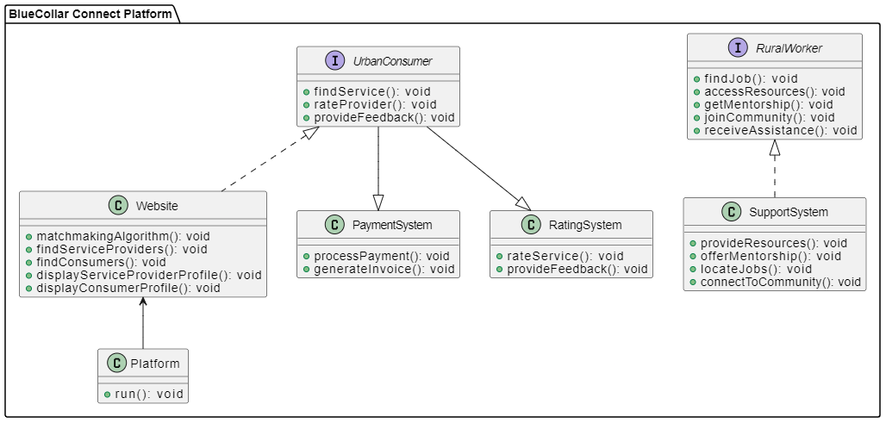
UML Class Diagram
Association

Slide 46
UML Class Diagram
Aggregation

Slide 47
UML Class Diagram
Inheritance

Slide 48
UML Class Diagram
Multiplicity

Slide 49
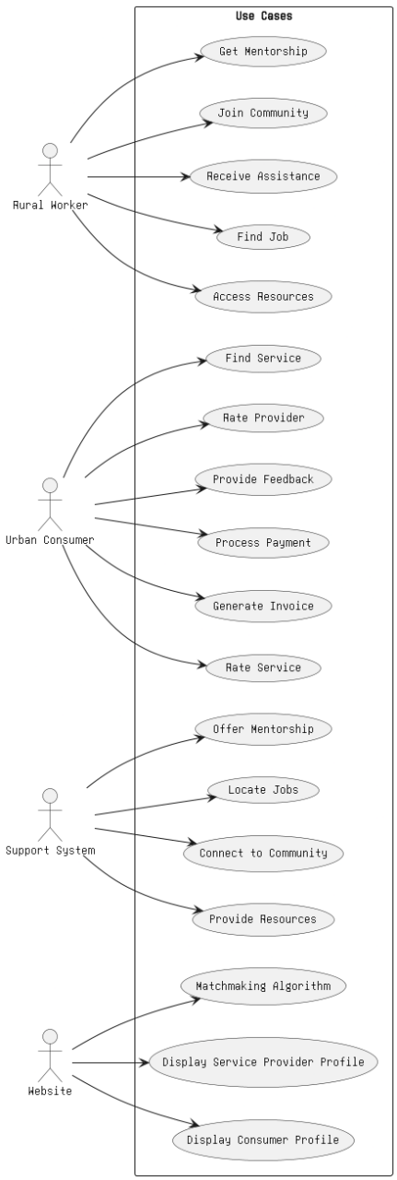
Sample Domain Model

Slide 50
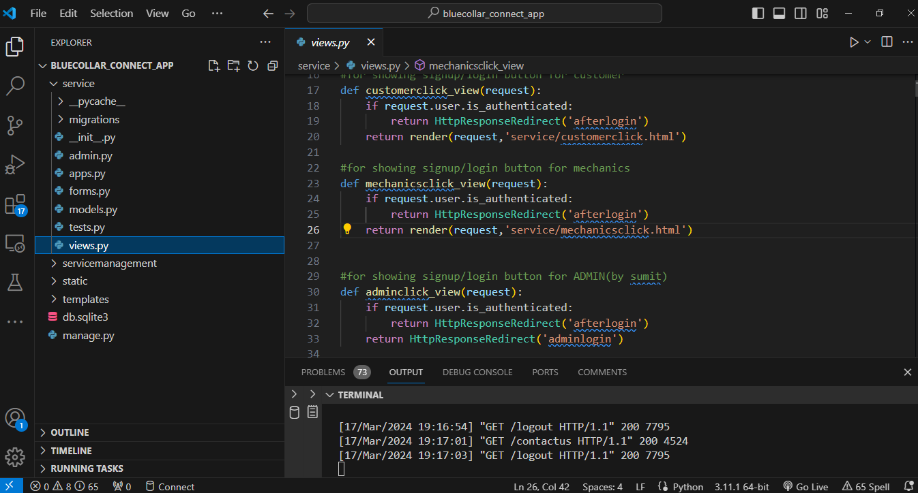
Proof Of Version Control
During this iteration, version control wasn't employed; instead, we relied on code backups as our primary method of safeguarding our work.Moving forward, we are committed to including version control into our workflow in order to improve collaboration and streamline the development process.

Slide 51
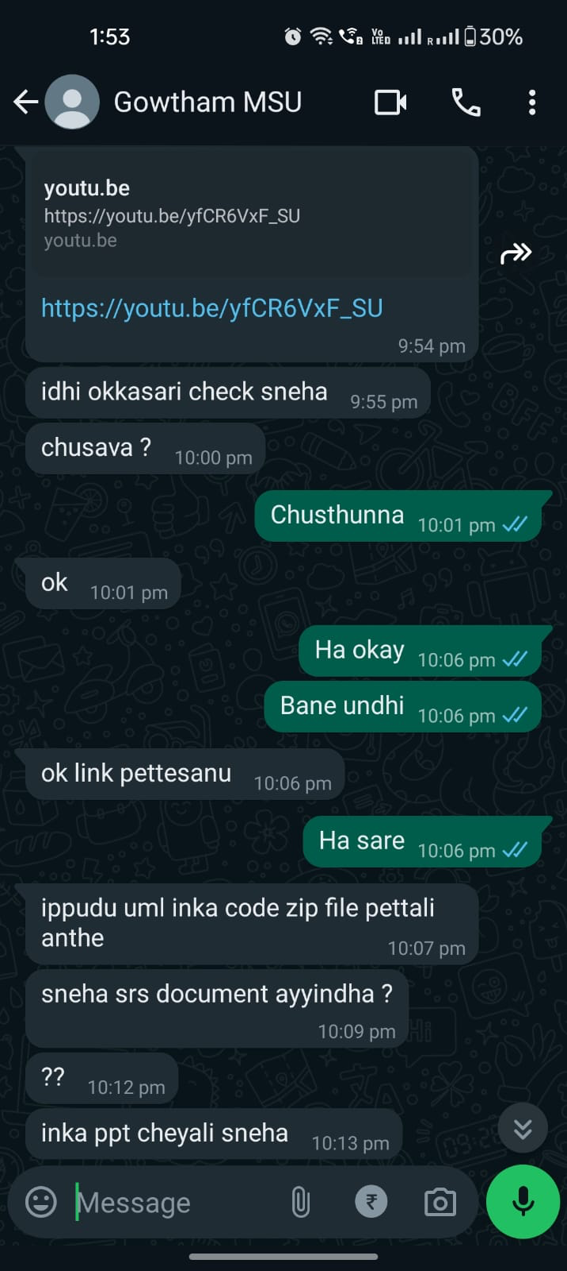
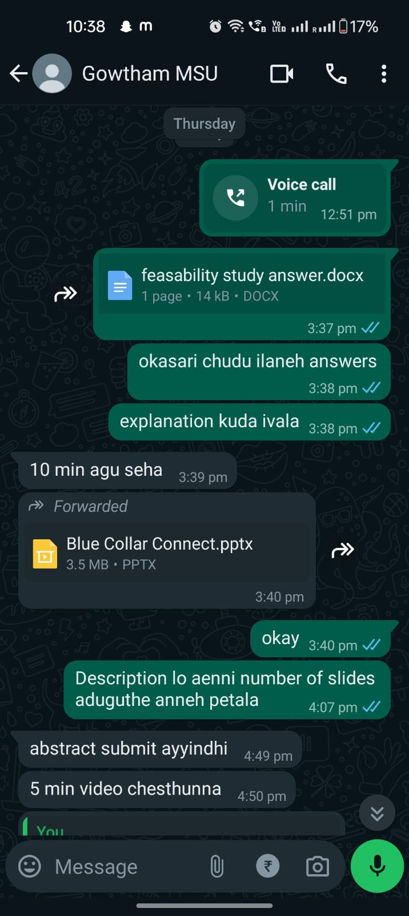
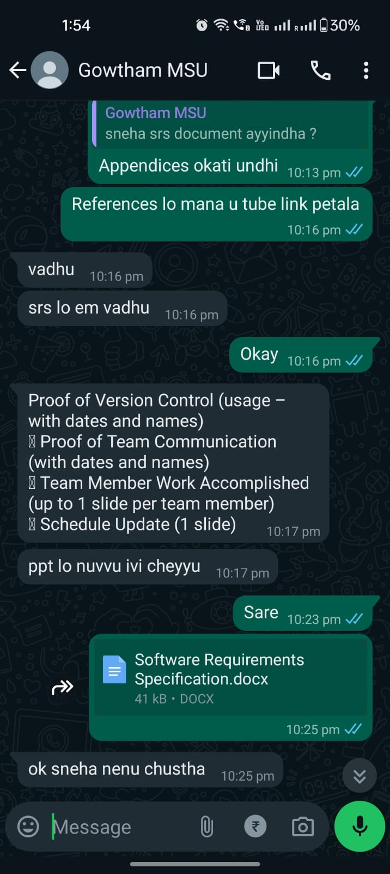
Proof Of Team Communication

Slide 52
Team Member Work Accomplished
Team Member | Iteration 2
Dendi Sneha Reddy | Team Leader, focused on learning django and implementing backend functionality.Worked on the feasibility study. Researched on project viability, defining functional and non-functional requirements, and organizing presentation requirements. Additionally led the team meetings and divided the work.while also producing initial rough diagrams and obtaining software requirement specifications.
Mallu Gowtham Reddy | learned Django technology to enhance his development skills. Worked on abstract. Focused on designing the homepage with a search bar and implementing the payments page and collaborated on translating UML diagrams. He took the lead in creating a video showcasing the project's user interface and functionalities.

Slide 53
Schedule Update
The Login, Registration, and homepage pages have been finalized, along with the cancellation feature, ensuring secure user access to the platform. Additionally, the payments page has been implemented to facilitate transactions.
The project's overall structure has been finalized, detailing its organization and workflow.
The database setup has been completed, providing a solid foundation for data management.

Slide 54
Project Demo
project Demo:- https://youtu.be/yfCR6VxF_SU

Slide 55
Zip File
https://drive.google.com/drive/folders/1_6cPnQAQMt9p3gZjF3PQXUICsWgUca_P?usp=drive_link

Slide 56
Thank You !

